Slide 1
Direct Preference Optimization: Your Language Model is Secretly a Reward Model

Slide 2
Summary
DPO is a computationally efficient method that calculated the log probabilities of preferred and dispreferred completions under a model and optimizes its parameter in a way to increase the likelihood of preferred responses and decrease those dispreferred to align the model with human preferences.

Slide 3
Contents
Background and Contribution
Preliminaries
DPO method
Experiment setup
Results
Conclusion and Future works

Slide 4
Contents
Background and Contribution
Preliminaries
DPO method
Experiment setup
Results
Conclusion and Future works

Slide 5
Background
LLMs possess great capabilities due to its training on a large variety of datasets with different goals, skillsets and priorities.
But some of them are not desirable.
For example: we need a model to know about common misconceptions among people but the model should be aware that it s misconception.

Slide 6
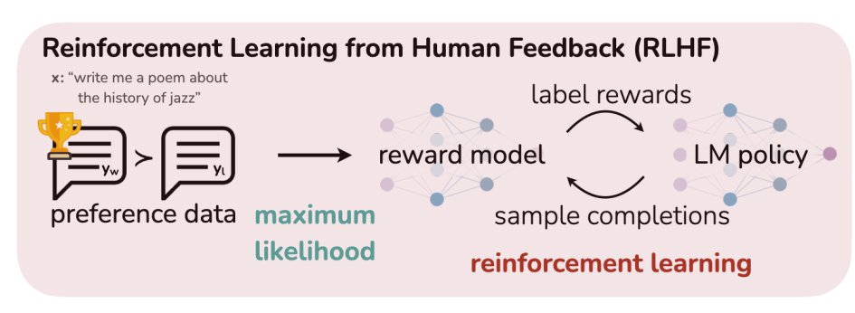
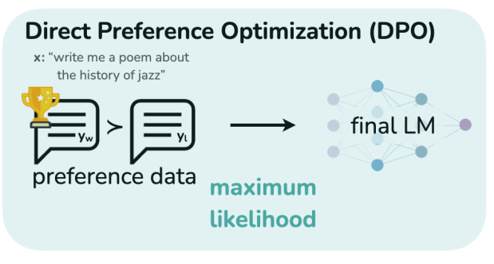
RLHF vs DPO

Slide 7
Contribution
Propose Direct Preference Optimization (DPO), a simple RL-free algorithm for training language models from preferences.
It is an algorithm that optimizes the constrained reward maximization problem with a single stage of policy training.
The DPO can understand and generate texts that people like.
It collects data from people's feedback and trains a "reward model" to understand people's likes and dislikes.
This reward model helps tune the behavior of the language model to more closely match human preferences

Slide 8
Contents
Background and Contribution
Preliminaries
DPO method
Experiment setup
Results
Conclusion and Future works

Slide 9
Preliminaries
Reinforcement learning from human feedback (RLHF) is a technique for training large language models (LLMs) to generate text that is aligned with human preferences.
RLHF works by first collecting a dataset of human preferences, which are pairs of text snippets, one of which is preferred by humans and the other is not.
The LLM is then trained to generate text that is more likely to be preferred by humans, using reinforcement learning.
RLHF consists of three phases
1. Supervised Fine-Tuning (SFT) phase
2. Reward Modeling phase
3. RL Fine-tuning phase

Slide 10
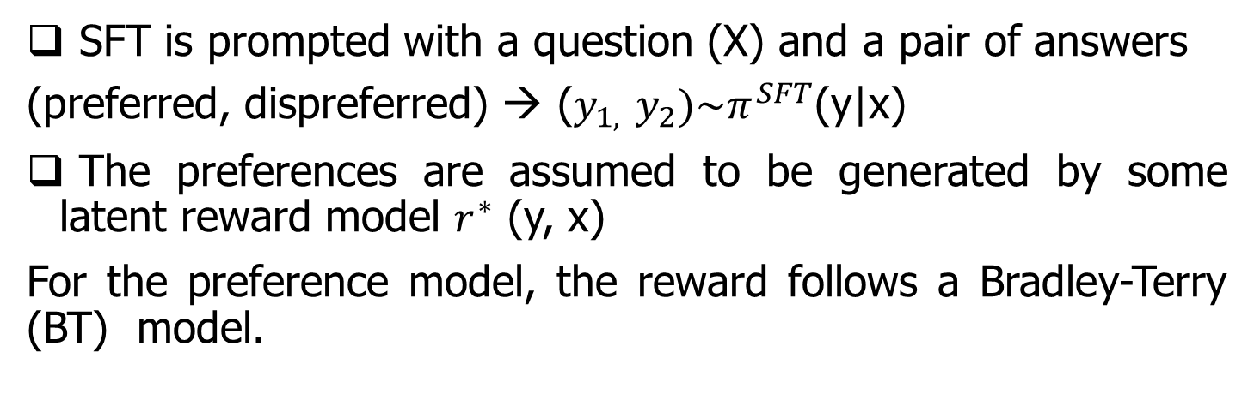

SFT phase
By supervising finetuning, on a high-quality dataset like instruction tuning it will result in a model called $π^{SFT}.$
Reward Modeling phase (1/3)
SFT is prompted with a question (X) and a pair of answers
(preferred, dispreferred) → ($y_{1,}$ $y_{2})\sim π^{SFT}$(y|x)
The preferences are assumed to be generated by some latent reward model $r^{∗}$ (y, x)
For the preference model, the reward follows a Bradley-Terry (BT) model.

Slide 11
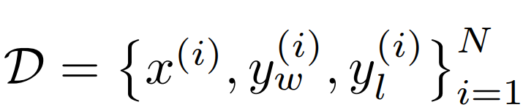
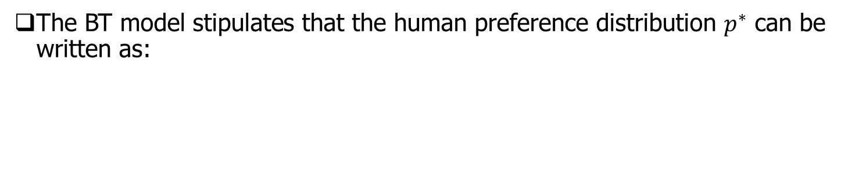
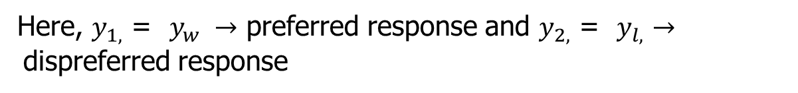
Reward Modeling phase (2/3)
The BT model stipulates that the human preference distribution $p^{∗}$ can be written as:
Here, $y_{1,}$ = preferred response and $y_{2,}$ = dispreferred response
Assuming access to a static dataset of comparisons
Here, $x^{(i)} is your input data.$
Here, $y_{1,}$ = $y_{w} →$ preferred response and $y_{2,}$ = $y_{l,}→$dispreferred response

Slide 12
Reward Modeling phase (3/3)
A reward model $r_{∅,}$ (x, y) can be parametrized under $∅$ and estimate the parameters via maximum likelihood
Considering the problem as a binary classification the negative log-likelihood loss can be formulated as :
Minus expectation
where σ is the logistic function.
In LMs, the network $r_{∅,}$ (x, y) is often initialized from the SFT model $π^{SFT}$(y|x) with a final layer added to provide the reward value.
To ensure a reward function with lower variance, prior works normalize the rewards, such that

Slide 13
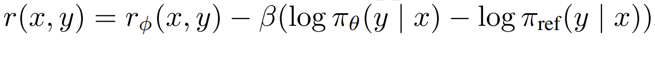

RL Fine tuning phase
The reward function is used to optimize the model as follows
Where β is a hyperparameter for controlling and $𝒟_{KL,}$ is the KL divergence.
$π_{θ,}→LLM ,{ π}_{ref,}→reference policy or model$
The final reward function r(x,y) can be calculated with the following equation
And the aim is to maximize this reward using PPO (Proximal policy optimization)

Slide 14
Challenges in RLHF
Here are some disadvantages of RLHF
Computational complexity
Data collection – require large data set
Bias- The result will be biased.
Scalability

Slide 15
Contents
Background and Contribution
Preliminaries
DPO method
Experiment setup
Results
Conclusion and Future works

Slide 16
DPO Method
To solve the challenges of RLHF on a large scale problem DPO approach was introduced which will bypass the reward modeling step and directly optimize a language model using preference data.
In DPO, the loss function is transformed into a loss function over policies which allows skipping the reward modeling step in RLHF but still preference model Bradly Terry is used for the optimization.

Slide 17
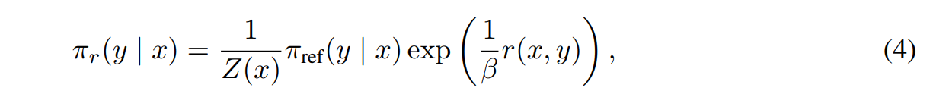
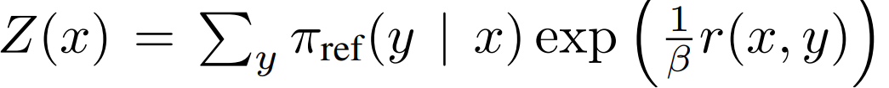
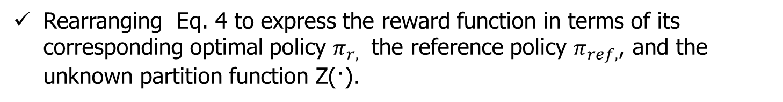
Deriving the DPO objective (1/3)
We drive the DPO using the same RL objective as Eq. (3). Under a general reward function r, the optimal solution with KL-constrained reward maximization objective becomes
where Z(x) is the partition function which is derived by
Rearranging Eq. 4 to express the reward function in terms of its corresponding optimal policy $π_{r,}$ the reference policy $π_{ref,}$, and the unknown partition function Z(·).
Specifically, we first take the logarithm of both sides of Eq. 4 and then with some algebra we obtain:

Slide 18
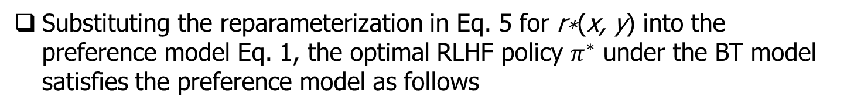
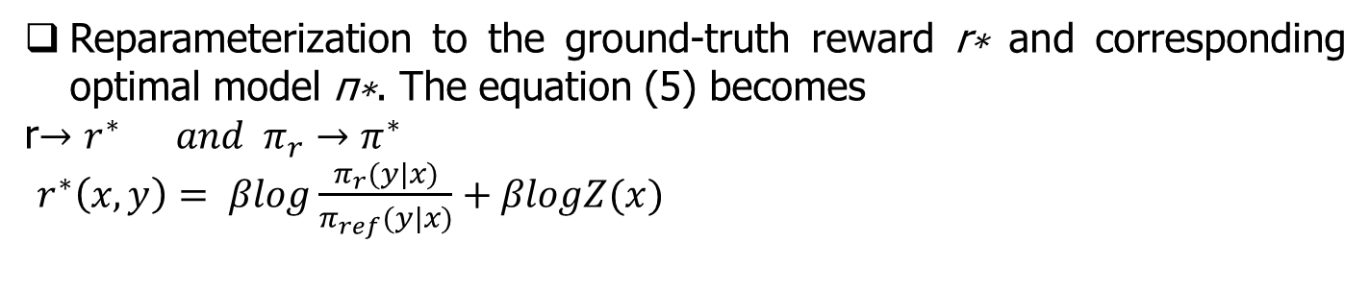
Deriving the DPO objective (2/3)
Reparameterization to the ground-truth reward r∗ and corresponding optimal model π∗. The equation (5) becomes
r${→r}^{∗} and π_{r}→π^{∗}$
$r^{∗}\left(x,y\right)= βlog\frac{π_{r}(y|x)}{π_{ref}(y|x)}+βlogZ(x)$
Since the Bradley-Terry model depends only on the difference of rewards between two completions
Substituting the reparameterization in Eq. 5 for r∗(x, y) into the preference model Eq. 1, the optimal RLHF policy $π^{∗}$ under the BT model satisfies the preference model as follows

Slide 19
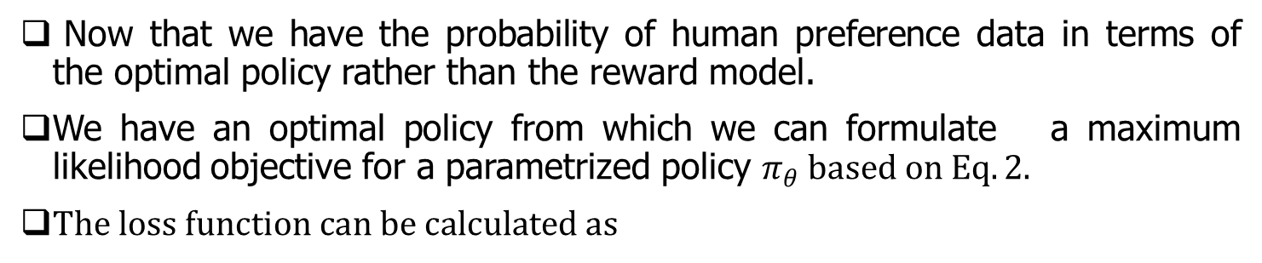
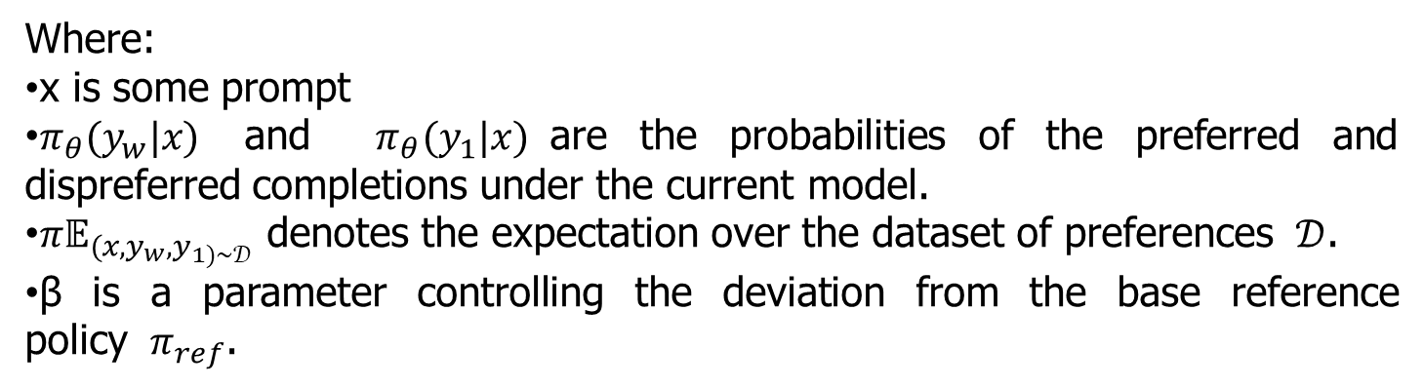
Deriving the DPO objective (3/3)
Now that we have the probability of human preference data in terms of the optimal policy rather than the reward model.
We have an optimal policy from which we can formulate a maximum likelihood objective for a parametrized policy $π_{θ} based on Eq.2.$
$The loss function can be calculated as$
Where:
x is some prompt
$π_{θ}(y_{w}|x)$ and $π_{θ}(y_{1}|x)$are the probabilities of the preferred and dispreferred completions under the current model.
${π𝔼}_{(x,y_{w},y_{1)\sim 𝒟}}$ denotes the expectation over the dataset of preferences $𝒟$.
β is a parameter controlling the deviation from the base reference policy $π_{ref}$.
The above equation shows the formulation of DPO loss which bypass the reward modeling step.

Slide 20
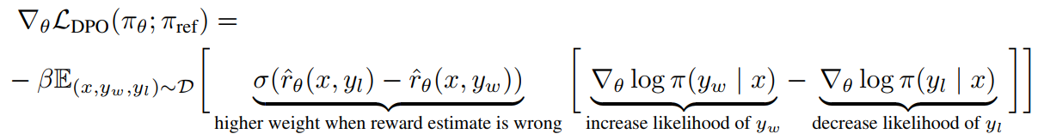
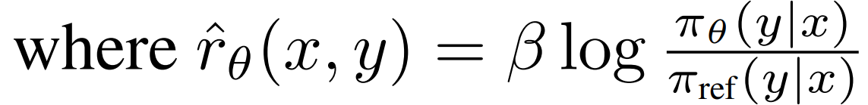
DPO Update
The gradient of the loss function LDPO increases the likelihood of the preferred completions yw and decreases the likelihood of dispreferred completions yl. The gradient with respect to the parameters θ can be written as:
This is our final DPO reward function.
In DPO, there is no negative reward (punishment) like RLHF.

Slide 21
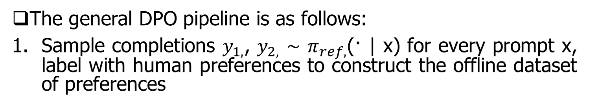
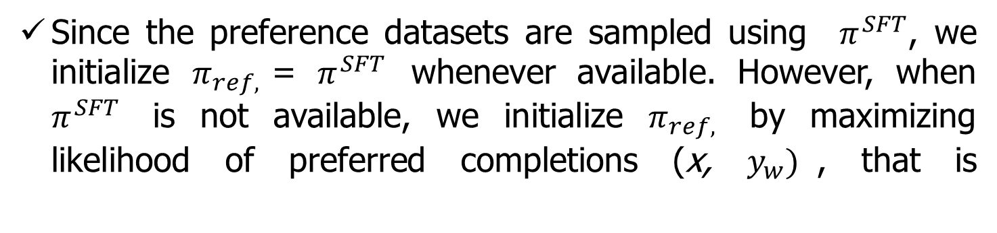
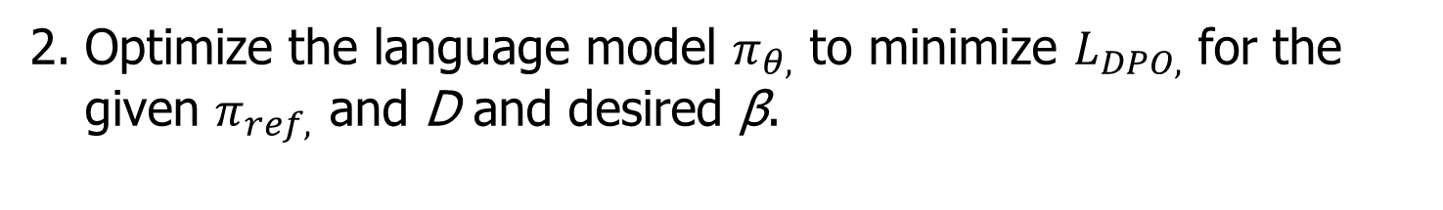
DPO Outline
The general DPO pipeline is as follows:
Sample completions $y_{1,}$, $y_{2,}$ ∼ $π_{ref,}$(· | x) for every prompt x, label with human preferences to construct the offline dataset of preferences
Optimize the language model $π_{θ,}$ to minimize $L_{DPO,}$ for the given $π_{ref,}$ and D and desired β.
Since the preference datasets are sampled using $π^{SFT}$, we initialize $π_{ref,}$= $π^{SFT}$ whenever available. However, when $π^{SFT}$ is not available, we initialize $π_{ref,}$ by maximizing likelihood of preferred completions (x, $y_{w})$, that is

Slide 22
Implementation Procedure
Step 1: Initial model training: First, train a language model using a large text dataset. This model can predict the next word in a sentence.
Step 2: Human Feedback: People provide feedback on the generated text. They rank different answers based on which answers they like most and which they dislike.
Step 3: Compensation model creation: A “reward model” is created using human feedback. This model assigns scores to different answers based on how much people like them.
Step 4: Model Tuning: The original language model is trained using the reward model. This allows the language model to generate text that people like more.

Slide 23
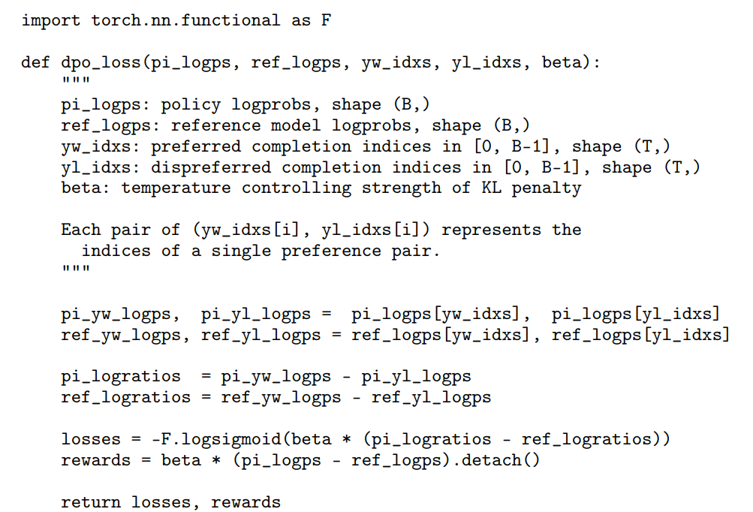
DPO Implementation by PyTorch
Hyperparameters
β = 0.1,
batch size of 64
The Adam optimizer with a learning rate of 1e-6 by default.
linearly warmup the learning rate from 0 to 1e-6
Number of epochs 150 steps.

Slide 24
Contents
Background and Contribution
Preliminaries
DPO method
Experiment setup
Results
Conclusion and Future works

Slide 25
Experimental Setup (1/3)
The experiments in this paper are mainly based on two question
How does DPO compare with common preference learning algorithms (such as PPO) between maximizing reward and minimizing KL-divergence with the reference policy?
How does DPO perform on larger models and more difficult RLHF tasks, including summarization and dialogue?

Slide 26
Experimental Setup (2/3)
Tasks
Controlled sentiment generation (IMDb dataset + generated preference pairs): where x is a prefix of a movie review from the IMDb dataset and the policy must generate y with positive sentiment.
Summarization (Reddit TL;DR dataset + gathered human preference pairs): x is a forum post from Reddit; the policy must generate a summary y of the main points in the post. For SFT, use
https://huggingface.co/CarperAI/openai_summarize_tldr_sft
Single tune dialogue (Anthropic Helpful and Harmless dialogue dataset with preference pairs): No pre-trained SFT model is available; we therefore fine-tune an off-the-shelf language model on only the preferred completions to form the SFT model

Slide 27
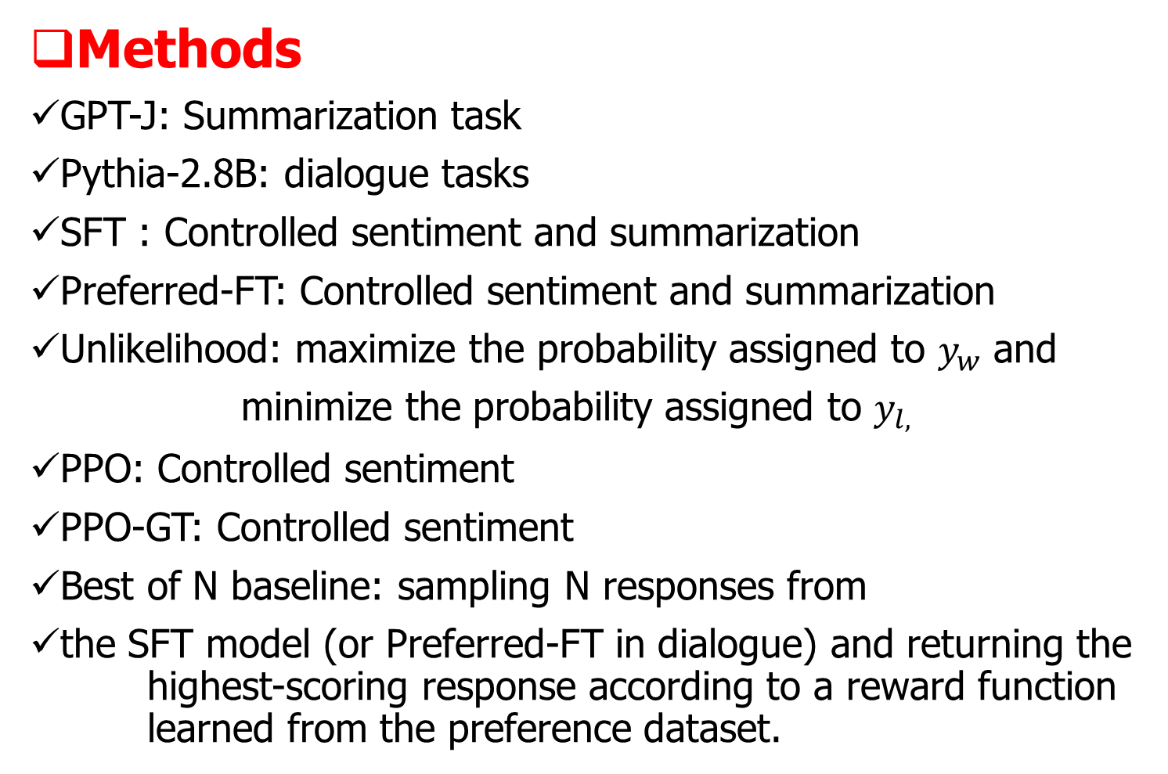
Experimental Setup (3/3)
Methods
GPT-J: Summarization task
Pythia-2.8B: dialogue tasks
SFT : Controlled sentiment and summarization
Preferred-FT: Controlled sentiment and summarization
Unlikelihood: maximize the probability assigned to $y_{w}$ and
minimize the probability assigned to $y_{l,}$
PPO: Controlled sentiment
PPO-GT: Controlled sentiment
Best of N baseline: sampling N responses from
the SFT model (or Preferred-FT in dialogue) and returning the highest-scoring response according to a reward function learned from the preference dataset.

Slide 28
Contents
Background and Contribution
Preliminaries
DPO method
Experiment setup
Results
Conclusion and Future works

Slide 29
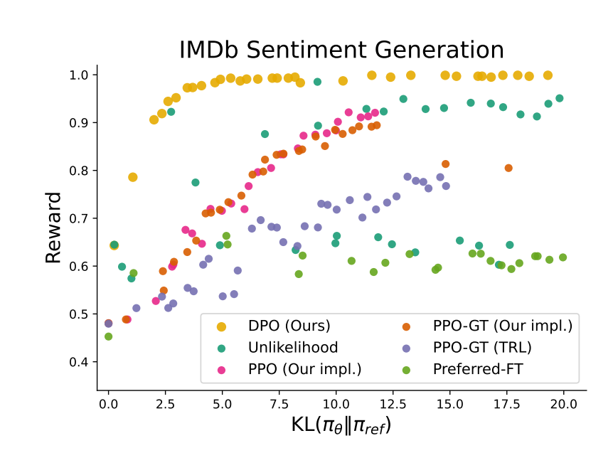
Results (1/4)
Figure 2:The frontier of expected reward vs KL to the reference policy. DPO provides the highest expected reward for all KL values, demonstrating the quality of the optimization.
DPO produces higher rewards than other methods. Due to
First, DPO and PPO optimize the same objective, but DPO is notably more efficient; DPO’s reward/KL tradeoff strictly dominates PPO.
Second, DPO achieves a better frontier than PPO, even when PPO can access ground truth rewards (PPO-GT)

Slide 30
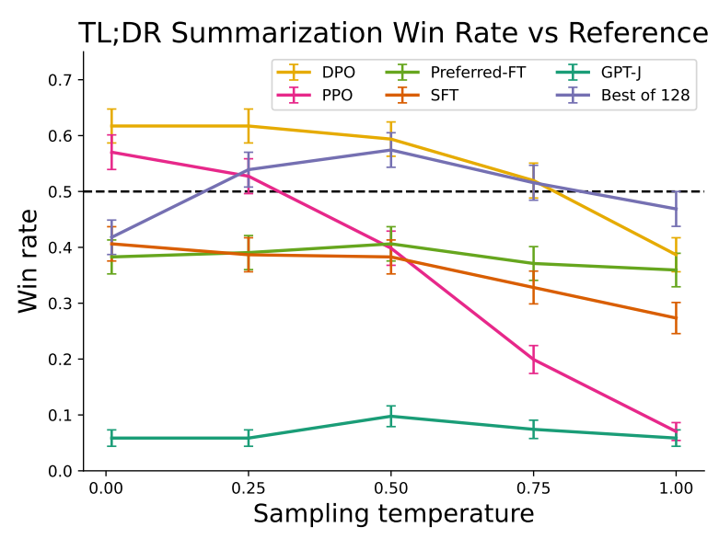
Results (2/4)
The temperature parameter is an important hyperparameter in generative language models that can be used to control the randomness and creativity of the generated text.
Figure 3: TL;DR summarization win rates vs. human-written summaries, using GPT-4 as evaluator. DPO exceeds PPO’s best-case performance on summarization, while being more robust to changes in the sampling temperature.
DPO has a win rate of approximately 61% at a temperature of 0.0, exceeding the performance of PPO at 57%.
DPO also achieves a higher maximum win rate compared to the best of N baseline.

Slide 31
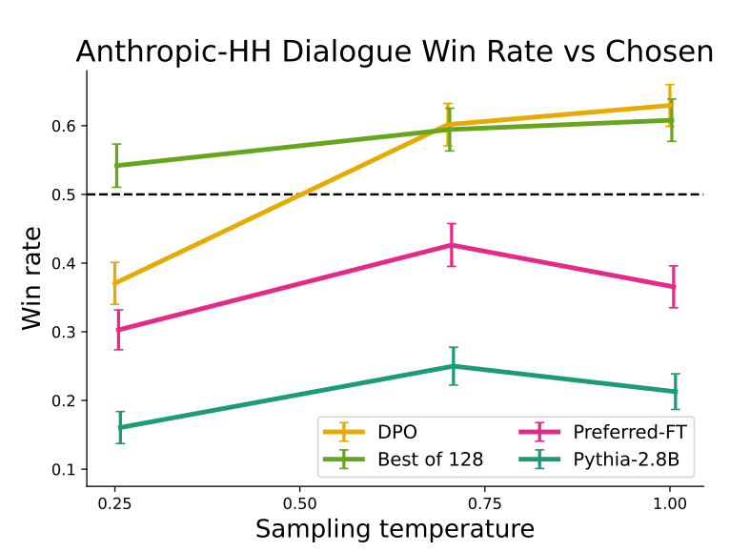
Results (3/4)
Win rates computed by GPT-4 for Anthropic-HH one-step dialogue; DPO is the only method that improves over chosen summaries in the Anthropic-HH test set.

Slide 32
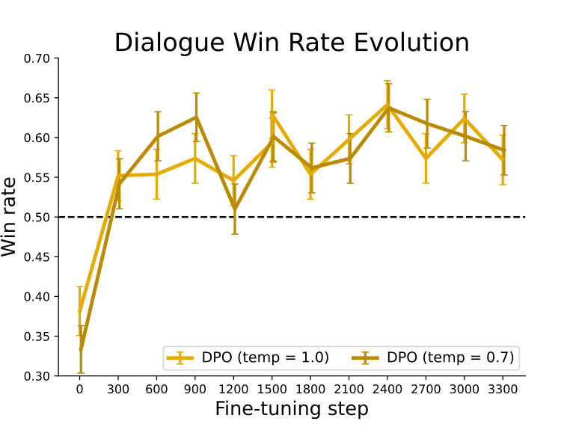
Results (4/4)
Win rates for different sampling temperatures over the course of training. DPO’s improvement over the dataset labels is fairly stable over the course of training for different sampling temperatures.

Slide 33
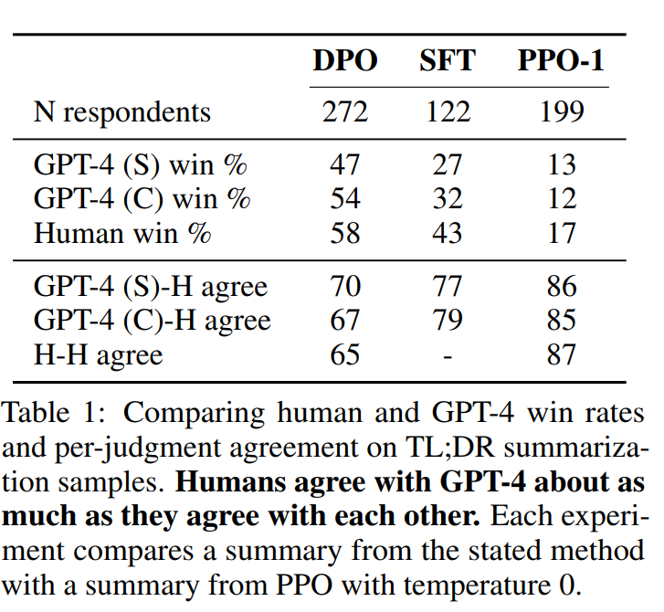
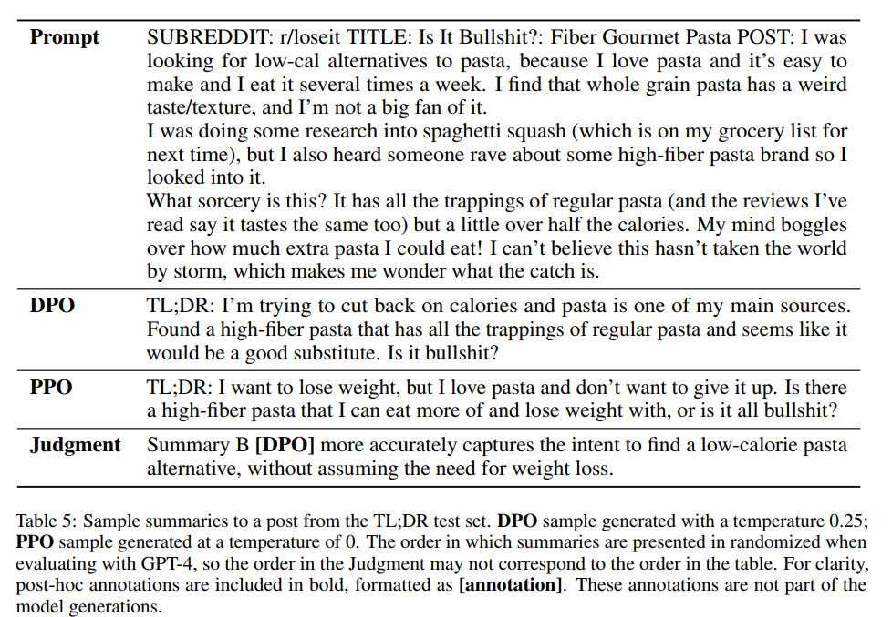
Validating GPT-4 judgments
GPT-4 tends to agree with humans about as often as agree with each other, suggesting that GPT-d is a reasonable proxy for human evaluations.

Slide 34
Contents
Background and Contribution
Preliminaries
DPO method
Experiment setup
Results
Conclusion and Future works

Slide 35
Conclusion
DPO identifies a mapping between language model (LM) policies and reward functions that enables training a LM to satisfy human preferences directly, with a simple cross-entropy loss, without RL.
No tuning of hyperparameters, DPO performs similarly or better than existing RLHF algorithms, including those based on PPO

Slide 36
Limitations and Future Works
How does the DPO policy generalize out of distribution, compared with an explicit reward function?
How does reward over-optimization manifest in the DPO setting?
Need to explore scaling DPO to state-of-the-art models larger than 6B.
Need to study the best way to elicit high-quality judgments. (e.g., GPT-4)
More possible applications of DPO.

Slide 37
Benefits of DPO
DPO simplifies the process of learning language models to generate better text.
It is easy to use and control as it is more stable and requires less complicated settings.
Make the behavior of the language model more effectively human-preferred.

Slide 38
Why is the DPO special
What makes DPO special is that it suggests ways to improve language models without resorting to complex techniques like reinforcement learning. Instead, we directly optimize the behavior of the model to match human preferences. This makes the technique more stable and easier to control.

